Slide 1
Command Line
BugSmashers

Slide 2
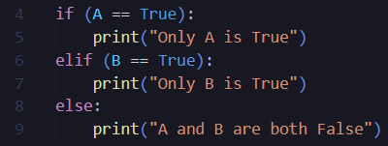
Icebreaker Time!
Spot the bug in this code:
Talk with the people at your table!

Slide 3
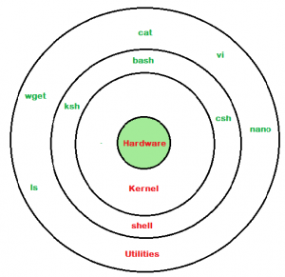

Layers of a Computer
Computers have many layers!
Hardware
Kernel
Shell
Utilities
When using the command line, you are giving instructions to the shell layer!

Slide 4
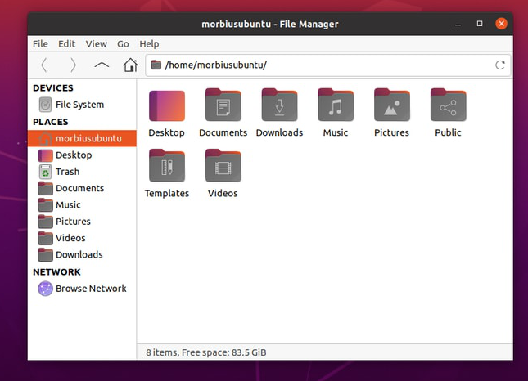
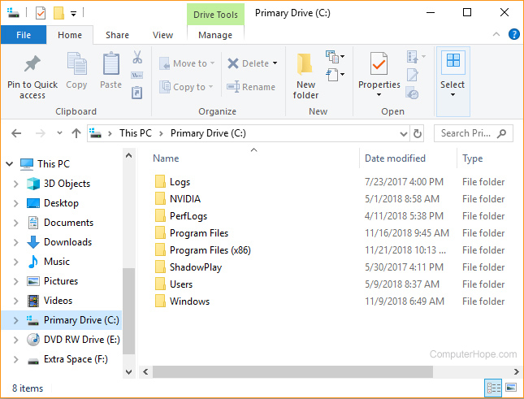

What is a GUI?
Has been used by everyone here
A way to interact with your operating system
Files, programs, anything else you might have on a computer

Slide 5



What is the command line interface?
A different way to interact with your operating system
Was initially created in the mid-1960s as an alternative to inputting punch cards into the computer
It is a text-based UI (no “fancy” visuals)

Slide 6
Advantages of using a CLI over a GUI
Less resource intensive
More control over a system
Has scripting capabilities (not doable with normal GUI)
More widely available on systems than a GUI
Can interact fully with a computer without the need for a mouse
Comes at a cost of a learning curve

Slide 7

What shell do you have?
MacOS will likely have zsh by default, or bash on older operating systems.
Linux operating systems (including Ubuntu) will likely have bash by default.
Windows will probably have PowerShell by default.
Zsh is essentially deluxe bash, with more features and customization.
This means any of the commands that can run on bash, will also run on zsh.

Slide 8
Many of these bash commands also exist as aliases in PowerShell*
Basic commands
bash / zsh | PowerShell | Purpose
ls | dir | List contents in the current directory
cd | chdir | Change current directory to one specified
mkdir | md | Creates a new directory (folder)
pwd | pwd | Returns the path of your current directory
touch | New-Item | Creates an empty file
rm | rmdir | Removes a file
exit | exit | Exits the current terminal

Slide 9

How do we use these?
Each command should be written with
Command name
Parameters
Flags (and optional parameters)
Example of making a new folder in the current directory:
mkdir my_new_folder (unix)
md my_new_folder (windows)
If you forget, most commands have:
<command-name> --help
If not, using the man command like such will provide a very detailed guide for you:
man <command-name>

Slide 10
Note on Flags
}
Flags are used to pass optional modifiers or extra parameters to command calls
The format for passing in these flags can either be single characters, or full words
Single character flags are preceded by one dash
Full word flags are preceded by two dashes
Everything is case sensitive!
“ls -a” is also “ls --all”
“ls -aR” is also “ls -a -R” and “ls --all --recursive”
In Powershell, flags are just evaluated by the tag (if not ambiguous), and are case insensitive.
“dir -force” is also “dir -fo” however…
“dir -f” does not work, because both the “-Force” and “-Filter” flags exist.
Unix

Slide 11

Demo/Live

Slide 12
More Commands
bash / zsh | PowerShell | Purpose
find | dir (args needed) | Returns files that matches description
grep | find | Returns data in file that matches description
file | (there is none 😔) | Reveals information about a file
cp | cp | Used to copy files or directories
clear | clear | Clears the previous writing from the terminal
cat | type | Print the contents of a file to terminal
sudo | (workaround needed) | Runs other commands with higher security privileges
Notes:
To add:
Nano - editing (can also use other commands like vim)
Cat - print contents of a file

Slide 13
Commands Continued
bash / zsh | Purpose
nano / vim / gedit | Opens the file in a given text editor
code | Opens a file in VSCode
fzf* | Filters through a piece of given input
ssh | Used to run commands on another computer
tar | Compresses/extracts files into .tar format
zip | Compresses/extracts files into .zip format
Notes:
To add:
Nano - editing (can also use other commands like vim)
Cat - print contents of a file

Slide 14
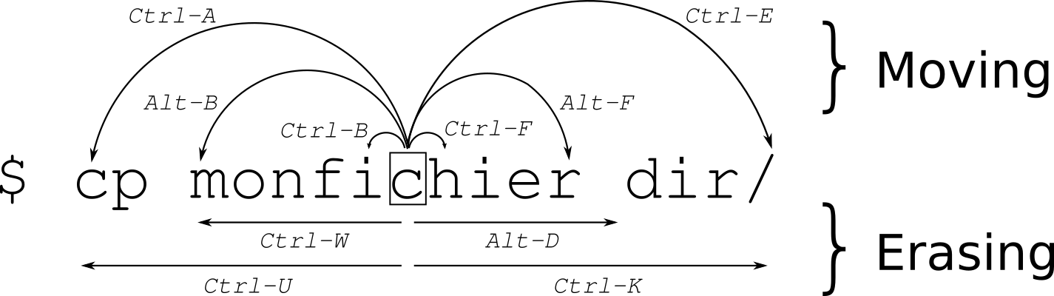
Helpful Keyboard Shortcuts
Arrow up / Arrow down | Scrolls through previously executed commands
Ctrl + C (or q) | Cancels the running command
Notes:
Ctrl + u

Slide 15
Piping with “ | ”
The pipe operator passed the output of one command into the input of the next command, from left to right
Ex:
ls | less
List all the files in the current directory
pass it into less to show the files in a different format
ls --all --recursive | find -size +100c | fzf | xargs rm
List all files recursively from the current directory and further “down”
Pass those files, then filter only files with a size above (indicated by ‘+’ suffix) 100 bytes (indicated by c)
Show those files to the user, and allow them to choose one file
Delete the file chosen by the user

Slide 16


Demo/Live

Slide 17

Thanks!
Do you have any questions?
@SwordPoro - Andrew’s Discord
@jarsnow - John’s Discord
Ask for help in the ACM Discord!

Slide 18
Icons

Slide 19




Alternative resources
Here’s an assortment of alternative resources whose style fits the one of this template:
Vectors
Abstract background with technological circuits

